Slide 1
Heart Disease Diagnostic Analysis
M. M. Mithun

Slide 2
AGENDA
Introduction
Data Overview
Key attributes included in the dataset
Dashboard
Thank You

Slide 3
INTRODUCTION
The COVID-19 pandemic has underscored the undeniable importance of health and medical preparedness. As we navigate through these unprecedented times, the significance of understanding and analyzing health data becomes increasingly apparent. In this context, our project titled "Heart Disease Diagnostic Analysis" aims to delve into the wealth of information available within heart disease diagnostic databases to extract valuable insights for better future preparation.
Heart disease remains one of the leading causes of mortality worldwide, affecting individuals of all ages, genders, and socioeconomic backgrounds. By leveraging data analytics techniques, we seek to uncover patterns, trends, and key metrics associated with heart disease diagnostics. Our analysis encompasses a comprehensive exploration of various attributes such as age, gender, chest pain type, blood pressure, cholesterol levels, and more, to gain a holistic understanding of the factors contributing to heart disease.

Slide 4
Data Overview
The dataset used for our analysis is sourced from a heart disease diagnostic database, containing a wealth of information crucial for understanding and assessing heart disease. This dataset comprises various attributes that play a significant role in diagnosing and predicting the likelihood of heart disease in individuals.

Slide 5
Key attributes included in the dataset
Age: The age of the individual, which is a crucial factor in assessing the risk of heart disease as it often correlates with other risk factors such as lifestyle, diet, and overall health.
Sex: The gender of the individual, which can influence the prevalence and manifestation of heart disease. Gender differences in heart disease rates and symptoms are well-documented in medical literature.
CP (Chest Pain Type): The type of chest pain experienced by the individual, which is an important symptom often used in diagnosing heart-related issues.
Trestbps (Resting Blood Pressure): The resting blood pressure of the individual, measured in mm Hg. Elevated blood pressure is a significant risk factor for heart disease.
Chol (Cholesterol): The cholesterol level of the individual, measured in mg/dL. High cholesterol levels are associated with an increased risk of heart disease.
Fbs (Fasting Blood Sugar): The fasting blood sugar level of the individual, measured in mg/dL. Elevated blood sugar levels may indicate insulin resistance, which is a risk factor for heart disease.
Restecg (Resting Electrocardiographic Results): The resting electrocardiographic results of the individual, which can provide valuable insights into heart function and potential abnormalities.
Thalach (Maximum Heart Rate Achieved): The maximum heart rate achieved by the individual during exercise, which is indicative of cardiovascular fitness and function.
Exang (Exercise Induced Angina): A binary variable indicating whether the individual experienced exercise-induced angina during diagnostic tests.
Oldpeak (ST Depression Induced by Exercise Relative to Rest): The ST depression induced by exercise relative to rest, which can provide information about myocardial ischemia and potential coronary artery disease.
Slope: The slope of the peak exercise ST segment, which is another indicator of myocardial ischemia.
Ca (Number of Major Vessels Colored by Fluoroscopy): The number of major vessels colored by fluoroscopy, which can provide information about the extent of coronary artery disease.
Thal (Thalassemia): A categorical variable indicating the type of thalassemia present, if any.
Target: A binary variable indicating the presence or absence of heart disease, with 1 representing the presence of heart disease and 0 representing the absence.
This dataset provides a comprehensive view of various factors associated with heart disease, enabling us to perform in-depth analysis and derive meaningful insights to inform future healthcare strategies and interventions.

Slide 6
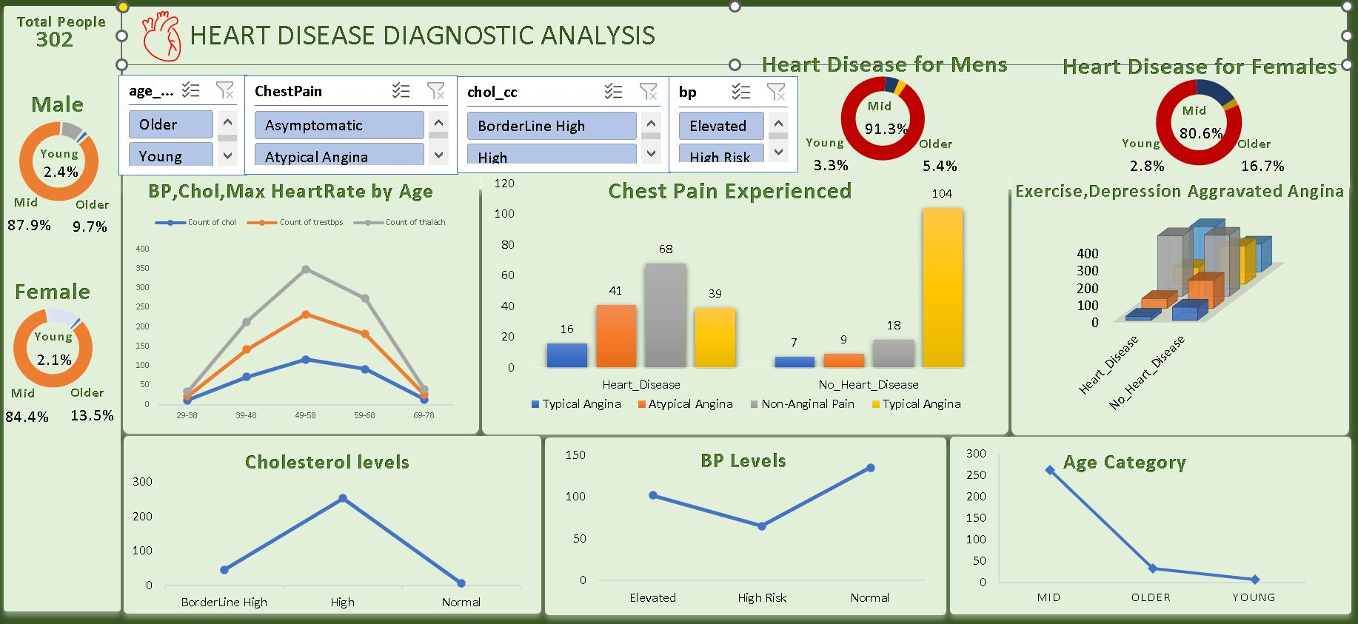
Heart Disease Dashboard

Slide 7
THANK YOU
Mithun M M
mithun2705@gmail.com

